Slide 1
Open Loop Control
Introduction

Slide 2

1
Problem Statement
2
Open Loop Control
Table of contents
3
Open Loop Control: Advantages
4
Open Loop Control: Disadvantages
5
Questions

Slide 3
Open Loop Control
Introduction

Slide 4

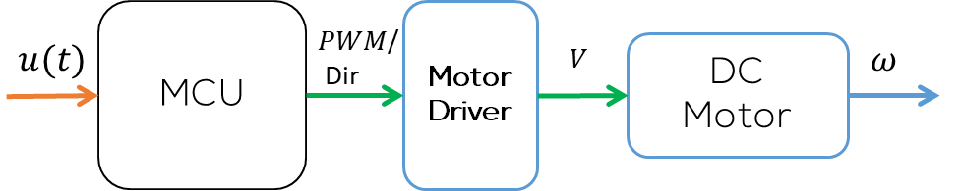
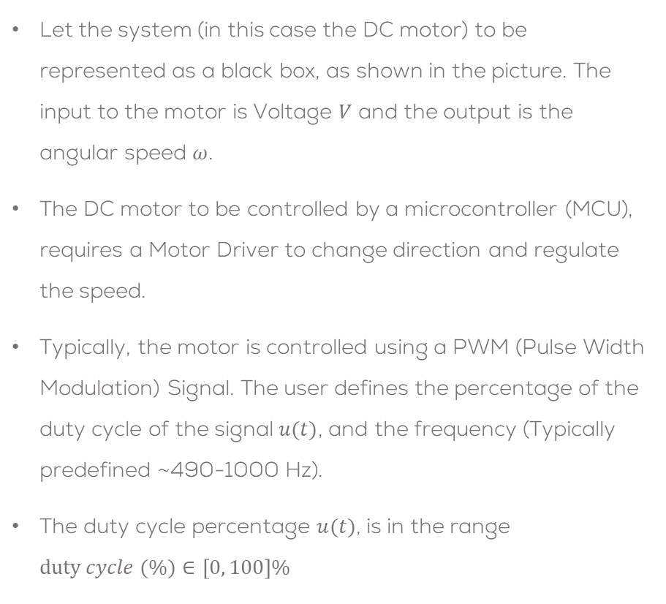


Problem Statement
Let the system (in this case the DC motor) to be represented as a black box, as shown in the picture. The input to the motor is Voltage $V$ and the output is the angular speed $ω$.
The DC motor to be controlled by a microcontroller (MCU), requires a Motor Driver to change direction and regulate the speed.
Typically, the motor is controlled using a PWM (Pulse Width Modulation) Signal. The user defines the percentage of the duty cycle of the signal $u(t)$, and the frequency (Typically predefined ~490-1000 Hz).
The duty cycle percentage $u(t)$, is in the range $duty cycle (\%)∈\left[0, 100\right]\%$
DC Motor
$$V$$
$$ω$$

Slide 5
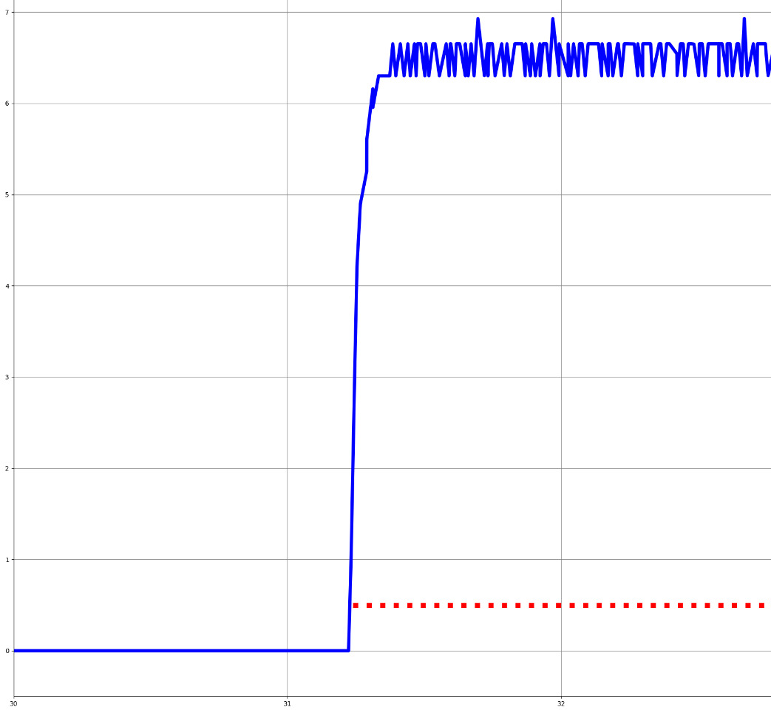
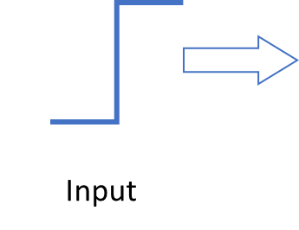
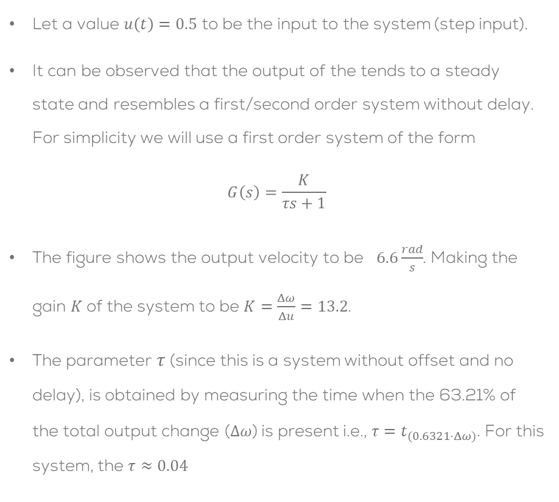
Problem Statement
Let a value $u\left(t\right)=0.5$ to be the input to the system (step input).
It can be observed that the output of the tends to a steady state and resembles a first/second order system without delay. For simplicity we will use a first order system of the form
$$G\left(s\right)=\frac{K}{τs+1}$$
The figure shows the output velocity to be $6.6\frac{rad}{s}$. Making the gain $K$of the system to be $K=\frac{Δω}{Δu}=13.2$.
The parameter $τ$ (since this is a system without offset and no delay), is obtained by measuring the time when the 63.21% of the total output change ($Δω$) is present i.e., ${τ=t}_{(0.6321⋅Δω)}$. For this system, the $τ≈0.04$

Slide 6
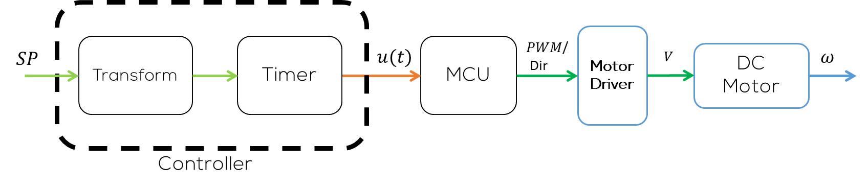
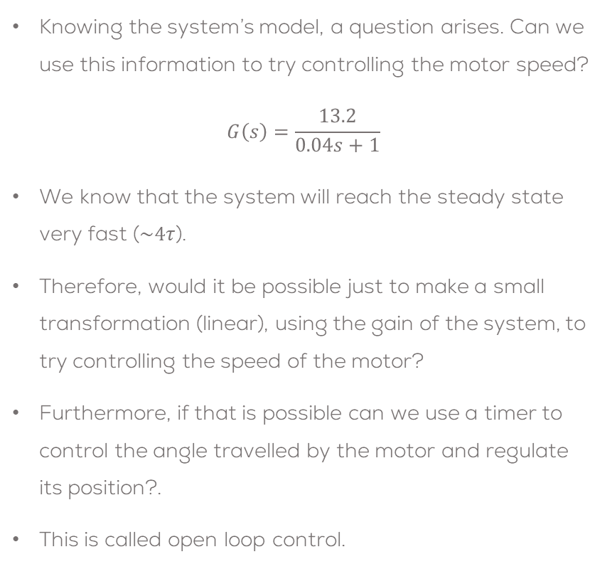
Problem Statement
Knowing the system’s model, a question arises. Can we use this information to try controlling the motor speed?
$$G\left(s\right)=\frac{13.2}{0.04s+1}$$
We know that the system will reach the steady state very fast ($\sim 4τ$).
Therefore, would it be possible just to make a small transformation (linear), using the gain of the system, to try controlling the speed of the motor?
Furthermore, if that is possible can we use a timer to control the angle travelled by the motor and regulate its position?.
This is called open loop control.

Slide 7
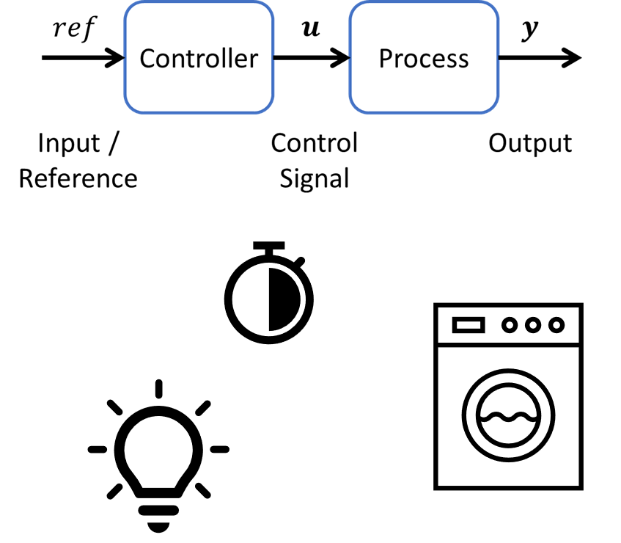
Open Loop Control
Open Loop Control System is a system in which the control action is independent of the output of the system.
In this type of control, the output is regulated by varying the input or reference.
The output of the system is determined by the current state of the system and the inputs that are received from the controller.
Some examples of this type of control systems are Windows, window blinds, washing machines, microwave ovens, hair drier, bread toaster, Door Lock System, some stepper motors, turning on/off lights, some remote-controlled applications, etc.

Slide 8
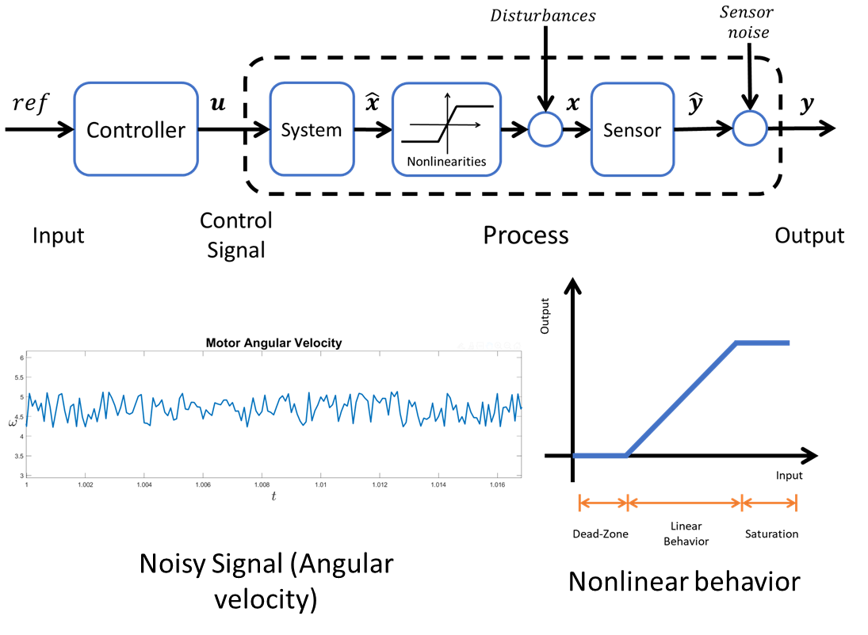
Open Loop Control
In reality, every process present disturbances, nonlinearities and noise.
Disturbances and noise come from the environment that surrounds the system.
On motor, some disturbances can come from manufacturing, environment perturbations, etc.
On the other hand, the noise is present when reading the values of the motor encoders (Sensors).
Nonlinearities are an intrinsic characteristic of a system in which the output does not linearly follow the input (output not proportional to the input).
For the case of the motor, the nonlinear behavior can be seen as a saturation and dead-zone.

Slide 9
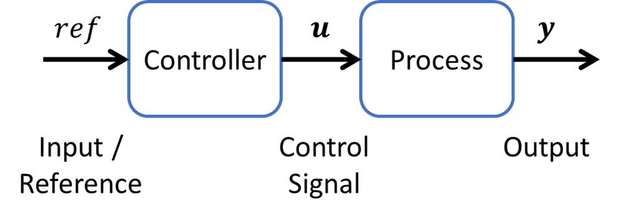
Open Loop Control: Advantages
Open Loop Advantages:
Simple to design and implement, provided that the user has some experience with the system.
The cost for design, implement and maintain is relatively low compared with other controllers.
Maintenance is considered simple, no high technical level required (for most of the controllers).
The behavior of the controller is quite stable, provided that the system is in a controlled environment, such that the process does not present big disturbances, or the process is not dangerous when unsupervised.

Slide 10
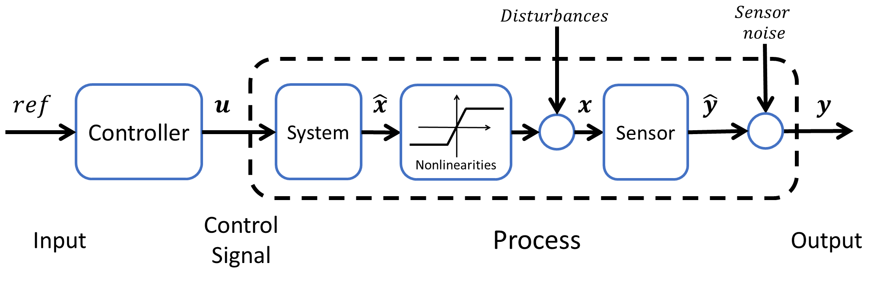
Open Loop Control: Disadvantages
Open Loop Disadvantages:
This type of control is not robust against disturbances (cannot correct the output in the presence of a disturbance).
An open-loop system has no self-regulation or control action over the output value.
Not reliable
The input depends on the experience of the user.
Each input determines a fixed operating point of the system.
Controller must be altered manually in case of an output disturbance or uncalibrated controller.
Requires re-calibration often.
Prone to errors in the output and control signal
Does not take into consideration changes on the process over time.
Also, there is no chance to correct the transition errors in open loop systems so there is more chance to occur errors.

Slide 11
Thank you

Slide 12
T&C
Terms and conditions

Slide 13
Terms and conditions
THE PIECES, IMAGES, VIDEOS, DOCUMENTATION, ETC. SHOWN HERE ARE FOR INFORMATIVE PURPOSES ONLY. THE DESIGN IS PROPRIETARY AND CONFIDENTIAL TO MANCHESTER ROBOTICS LTD. (MCR2). THE INFORMATION, CODE, SIMULATORS, DRAWINGS, VIDEOS PRESENTATIONS ETC. CONTAINED IN THIS PRESENTATION IS THE SOLE PROPERTY OF MANCHESTER ROBOTICS LTD. ANY REPRODUCTION, RESELL, REDISTRIBUTION OR USAGE IN PART OR AS A WHOLE WITHOUT THE WRITTEN PERMISSION OF MANCHESTER ROBOTICS LTD. IS STRICTLY PROHIBITED.
THIS PRESENTATION MAY CONTAIN LINKS TO OTHER WEBSITES OR CONTENT BELONGING TO OR ORIGINATING FROM THIRD PARTIES OR LINKS TO WEBSITES AND FEATURES IN BANNERS OR OTHER ADVERTISING. SUCH EXTERNAL LINKS ARE NOT INVESTIGATED, MONITORED, OR CHECKED FOR ACCURACY, ADEQUACY, VALIDITY, RELIABILITY, AVAILABILITY OR COMPLETENESS BY US.
WE DO NOT WARRANT, ENDORSE, GUARANTEE, OR ASSUME RESPONSIBILITY FOR THE ACCURACY OR RELIABILITY OF ANY INFORMATION OFFERED BY THIRD-PARTY WEBSITES LINKED THROUGH THE SITE OR ANY WEBSITE OR FEATURE LINKED IN ANY BANNER OR OTHER ADVERTISING.

